Slide 1
Child Poverty Jonathan Bradshaw
Public symposium
Is Japan an Equal Society?
Policies against poverty and social exclusion
Keio University
Tokyo
7 January 2012

Slide 2
Child poverty in the UK:1979-1995/6 60 per cent equivalent household income

Slide 3
The child poverty strategy to eradicate child poverty
Manage economy to ensure low inflation and high employment
Welfare to work
Increases in in-work benefits
Increases in out-of-work benefits
Big investment in services - health, education, childcare
Institutional transformation
Child Poverty Act and child poverty targets

Slide 4
Child poverty targets for 2020
Relative low income = Equivalised net household income less than 60% median 2020 target: <10% of children
Combined low income and material deprivation = Material deprivation >20% and equivalised net household income less than 70% median 2020 target: <5% of children
‘Absolute’ low income= Equivalised net household income falling below 60% of the ‘adjusted base amount’ 2020 target: <5% of children
Persistent poverty= Equivalised net household income less than 60% of median for 3 years prior to current year 2020 target: not yet set

Slide 5
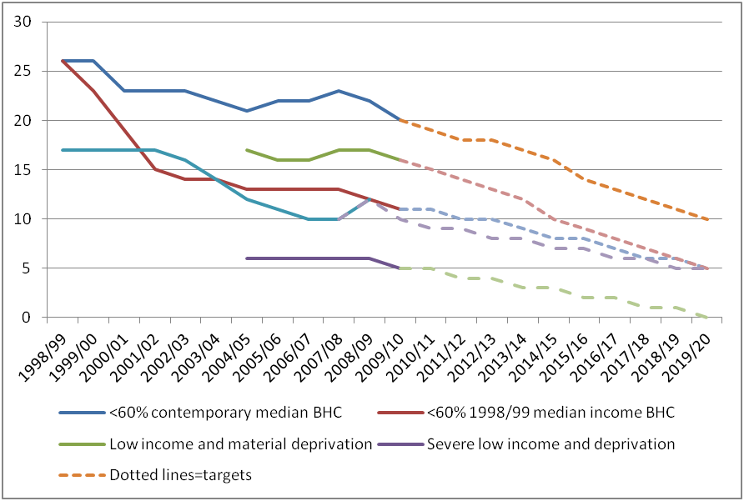
Child poverty fell – but not sustained

Slide 6
Child poverty rates in the OECD (<50% median) circa 2008 –UNICEF Innocenti Report Card 10

Slide 7
Transfers reduce child poverty but not by much in Japan

Slide 8
Now recession and new coalition government
Plan to cut £80 billion deficit by 2013
25% from increases in taxes
75% from cuts in services and huge reduction in public employment
Whole package highly regressive
Children have done much worse than pensioners
IFS say it will increase child poverty
Unemployment up – youth at record levels
Discourse has become behavioural
Focus on early years

